Slide 1
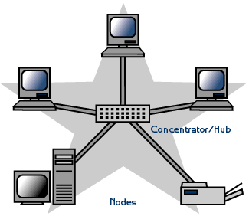
Star
A star topology is designed with each node (like workstations, printers, laptops, servers etc.) connected directly to a central device called as a network switch. Each workstation has a cable that goes from its network interface card (NIC) to a network switch.
A star network, where devices are connected to a central hub or switch.
Characteristics of Star Topology:
High Speed
Very Flexible
High Reliability
High Maintainability

Slide 2
Advantages and disadvantages of a star network
The advantages of a star network are:
Easy to manage and maintain the network because each node require separate cable.
Easy to locate problems because cable failure only affect a single user.
Easy to extend the network without disturbing to the entire network
Due to Hub device network control and management is much easier.
Fault identification and removing nodes in a network is easy.
It provides very high speed of data transfer.
The disadvantages of a star network are:
Entire performance of the network depends on the single device hub.
If the hub device goes down, the entire network will be dead.
Star topology requires more wires compared to the ring and bus topology.

Slide 3
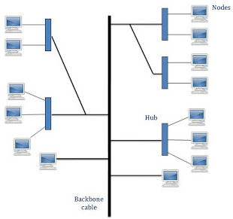
Tree
In Tree Topology, all the computer are connected like the branches of a tree. In Computer Networking, tree topology is known as a combination of a Bus and Start network topology. The main advantages of this topology are better flexibility and scalability.
Tree network topology is the simplest topology in which only one route exists between any two nodes on the network. The pattern of connection resembles a tree in which all branches spring from one root hence (Tree Topology).
Characteristics of Tree Topology:-
Ideal if nodes are located in groups.
Used in Wide Area Network.
Better Flexibility
Better Scalability

Slide 4
Advantages:-
It is a combination of bus and star topology
It provides high scalability, as leaf nodes can add more nodes in the hierarchical chain.
Other nodes in a network are not affected, if one of their nodes get damaged
It provides easy maintenance and fault identification.
Supported by several hardware and software vendors.
Point-to-point wiring for individual segments.
Disadvantages:-
Large cabling is required as compared to star and bus topology.
On the failure of a hub, the entire network fails.
Tree network is very difficult to configure than other network topologies.

